Slide 1
Global Configurations in Product Line Engineering
with pure::variants and the IBM ELM Platform
02.-04.11.2021
Notes:
20+5 minutes Thank you for the nice introduction and welcome everyone. In the following 20 minutes I want to work out the synergy between the OSLC Concept of Global Configurations and feature-based Product Line Engineering. To make this more graspable, we will have a look at a tool chain consisting of the IBM Engineering Lifecycle Management platform that implements Global Configurations and the PLE tool pure::variants that comes with a connector for the IBM ELM platform.

Slide 2
Agenda
Introduction
PLE in a nutshell
Global Configurations & PLE
Summary
Questions
Notes:
Before we get into the actual topic, I want to briefly introduce you to the company pure-systems that I‘m working for and that develops and distributes pure::variants. Next, I will give a brief explanation of Product Line Engineering. Prepared with that knowledge, we will have look at the synergies between Global Configurations as an OSLC concept and Product Line Engineering as a standard for systematic reuse of engineering assets and work out the advantages for companies that are developing product families of complex systems. After a brief summary we have some time reserved for your questions.

Slide 3
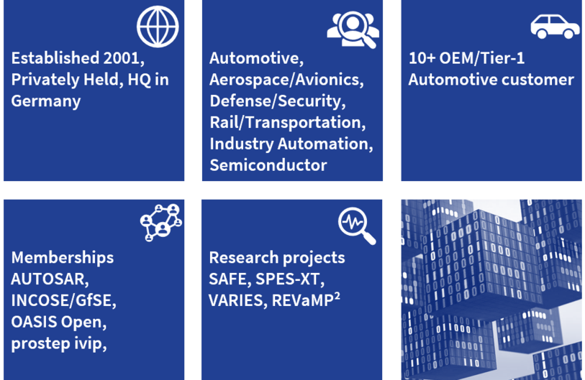
pure-systems at a glance
Notes:
pure-systems is on the market since 2001. We are headquartered in Magdeburg, Germany and are operating worldwide, fully focused on the topic of systematic reuse of engineering assets according to the product line engineering approach. Our customers mainly stem from industries that are developing complex systems consisting of hardware and software, like Automotive, Aerospace, Defense and Rail & Transporstation. As an INCOSE member, we are well connected into the systems engineering world and contributed to the ISO26580 Standard about feature-based Product Line Engineering. We are also involved in various research projects together with partners from industry, universities and research institutes and keep using joint research projects as a format to develop new ideas that find their way into pure::variants.

Slide 4


pure-systems offering
pure::variants offers a holistic solution to the challenges posed by an increasingly individualized and complex software engineering market. Slotting right into your existing process chains, pure::variants uses the similarities between products in your product lines to optimize the whole process.
Holistic thinking doesn’t end with development. That’s why we have created pure::consult – a comprehensive offering that combines consulting and other services. Our aim? To help you implement complex projects faster. We provide what you need to integrate pure::variants into your processes and tool chains perfectly, smoothly and pragmatically.
Notes:
Our offering consists of the variant management tool pure::variants that comes with integrations to various engineering tools to implement holistic variant management across the engineering lifecycle and across tool borders. This is accompanied by services. Under the brand pure::consult, we provide our customers with professional support that covers all phases from an early guided evaluation to the productive use of pure::variants.

Slide 5
PLE in a nutshell
What is Product Line Engineering?
Notes:
But, what does systematic reuse according to the feature-based product line engineering approach actually mean? Let me provide a brief introduction.

Slide 6
PLE in a nutshell
Variability
Model
150%
AUTOSAR
Models
Variant
Description
Model
Variability
Model
150%
AUTOSAR
Models
Variant
Description
Model
Feature
Model
150%
Engineering Asstes
Variant
Description
Model
Transformation
150%
AUTOSAR
Models
130%
Multi Variant
Model
150%
AUTOSAR
Models
150%
AUTOSAR
Models
150%
AUTOSAR
Models
130%
Multi Variant
Model
150%
AUTOSAR
Models
150%
AUTOSAR
Models
100%
AUTOSAR
Model
100%
Variant 1
100%
Variant 2
100%
Variant 3
Notes:
In PLE, we rely on two major concepts to achieve the systematic reuse of engineering assets. On one hand,
On, the other hand, we rely on feature modeling to capture on an abstract, engineering asset-independent level the differences that variants of our product line can have among each other. Each such difference is modeled as a feature and set into relation with the other features of a product line. For Example, a feature could be a functionality that is part of some, but not all variants. A Market for which we want to develop some varaints, can be a feature as well, as depending on the decission to provide variants for a specific market, those variants may require functionalities that are mandatory for this market but optional or non-available for other markets. Such interdependency information is formalized and put into the feature model, too. This feature model is connected to our 150% engineering assets to express that those variable parts of the assets are only needed for variants wherein certain features are relevant. Which features are relevant for a specific variant is configured in a so-called variant description model. This model contains all the features we defined in the feature model. In the VDM, we select those features of the feature model that shall be part of the variant. Our variant management tool is helping by taking into account all the interdependencies that have been modeled into the feature model and guides us through the variant configuration. Based on such a vdm, the variant-specific assets can be generated out of the 150% assets in a so-called transformation. The 100% are stored in the respective tool for this type of assets.

Slide 7
Global Configurations & PLE
Engineering Data Management + Automated Reuse
Notes:
After that brief introduction to PLE, let‘s come to the actual topic of today: Global Configurations in Product Line Engineering. We as well as our customer, see a huge synergy between the use of GCs for engineering data management and PLE for the systematic reuse of the engineering data across product variants.
--- And I want to give some insight into why, with the goal of making you aware of this strong synergy between Global Configurations and PLE.

Slide 8


Global Configurations & Streams
Global Configuration
(Product Line)
Requirements
Architecture
Test Cases
Code
Feature Model
& VDMs
pure::variants
transformation
pure::variants Stream, provided by pure::variants model server
Global Configuration (Variant A)
Global Configuration (Variant B)
Global Configuration (Variant C)
Global Configuration (Variant D)
Requirements
Architecture
Test Cases
Code
Requirements
Architecture
Test Cases
Code
Requirements
Architecture
Test Cases
Code
Requirements
Architecture
Test Cases
Code
Notes:
On its own, Global Configurations provide great value by giving engineers an entity under which they can baseline across engineeing assets of different type that reside in different version control systems. At the same time, Global Configurations provide a context in which links between engineering assets are valid. They provide the capability of creating a branch on GC level which implies the creation of a branch for each of the local streams that are part of a GC.
Product Line Engineering is interacting with GCs in two ways. On the one hand, PLE assets like feature models and variant description models, can become a part of a GC. The pure::variants model server, that manages these models, implements the stream provider interface to make it possible to include those models into a GC. This means, in the case you are using pure::varaints, PLE is out of the box integrated into GCs and feature models and variant models can become part of a GC baseline to express that these models are consistent with the 150% engineering assets and variant-specifc assets can be generated out of these. On the other hand, if you are using pure::variants, GCs are integrated into PLE. Instead of just generating a 100% requirements document from a 150% requirements document, pv can take whole GC with multiple streams with 150% engineering assets inside as an input and generate a variant-specific GC stream out of it that holds the generated output. As from the GC perspective those are the same assets in a separate branch, you can even continue to work on this 100% output with the option at hand to re-generate the same variant based on a newer baseline of the 150% assets to receive updates from the 150% without loosing local changes.

Slide 9
Use Cases of the systematic reuse scenario
Baselining across reusable assets
Centralized configuration of variants
Based on interdependency knowledge
Automated calculation and instantiation of variant-specific engineering assets
Based on centralized configuration
Keep traces between engineering assets intact
Flexibility to continue development in variant-specific engineering assets
Support automated updates
In case variant configuration changes
In case 150% engineering assets change
Support feedback of variant-specific engineering assets to reusable assets
Notes:
So lets have an intermediate overview of capabilities when combining those approaches:

Slide 10
Synergy of PLE & Global Configuations
Systematic reuse & evolution of engineering assets
Notes:
To make this more graspable, I want to give a demonstration of configuring a variant based on a feature model in pure::variants and the generation of a variant-specific GC out of a 150% GC as well as running an update of an already existing variant that has been changed manually. While pure::variants provides the capabilities needed to control variability in engineering assets based on feature selections, we will in addition use the IBM ELM Platform and DOORS Next as the tool platform that supports GCs.

Slide 11
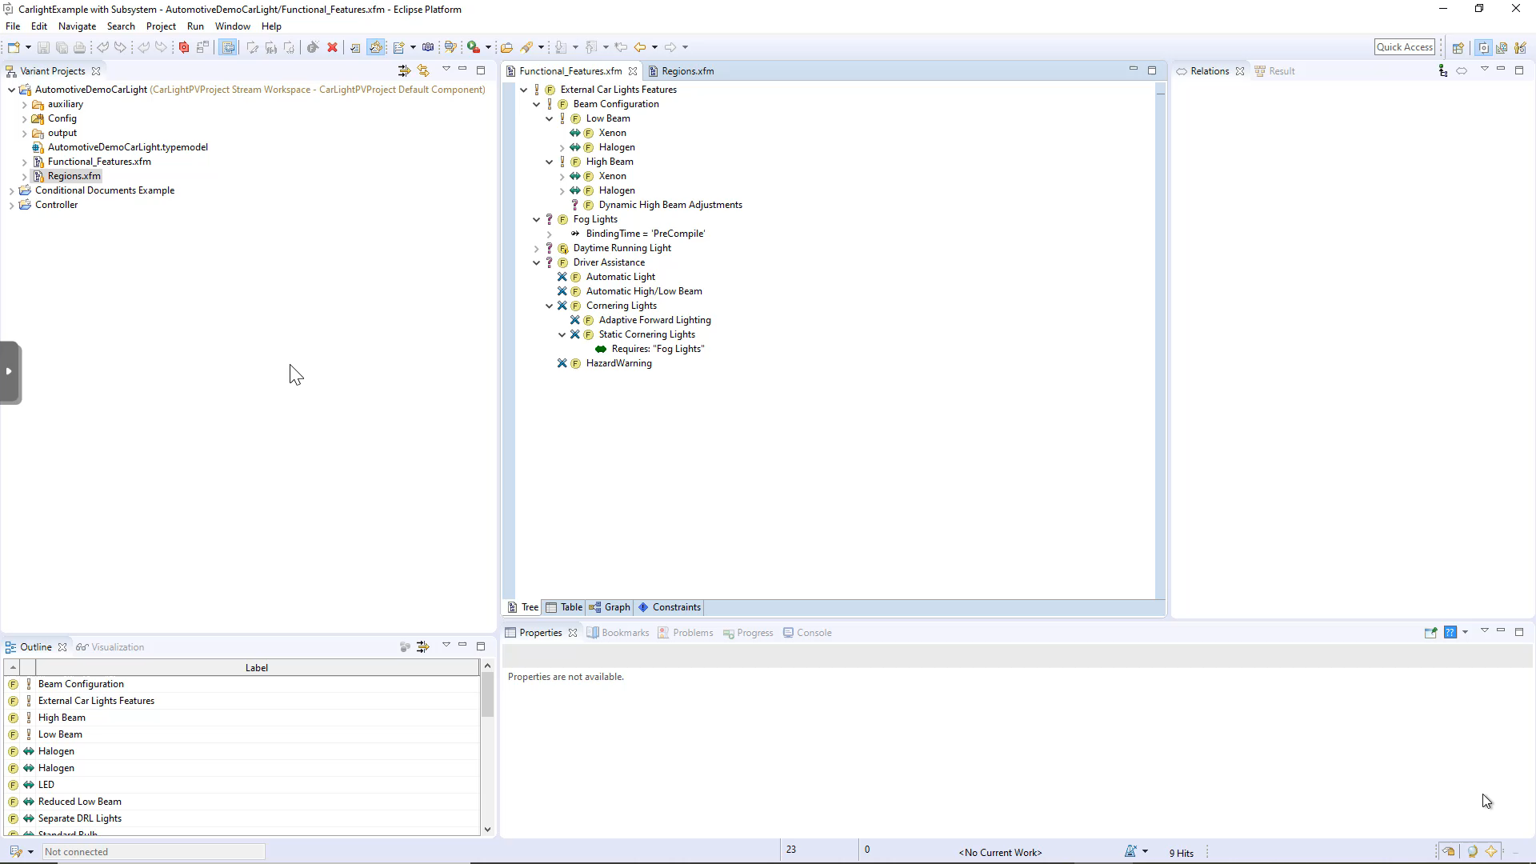
Configuring a new Variant
Notes:
Mandatory features are auto-selected
Error markers and suggestions during configuration
If we select a feature, its parents are auto-selected
Relations are auto-resolved
(1:45 min)

Slide 12
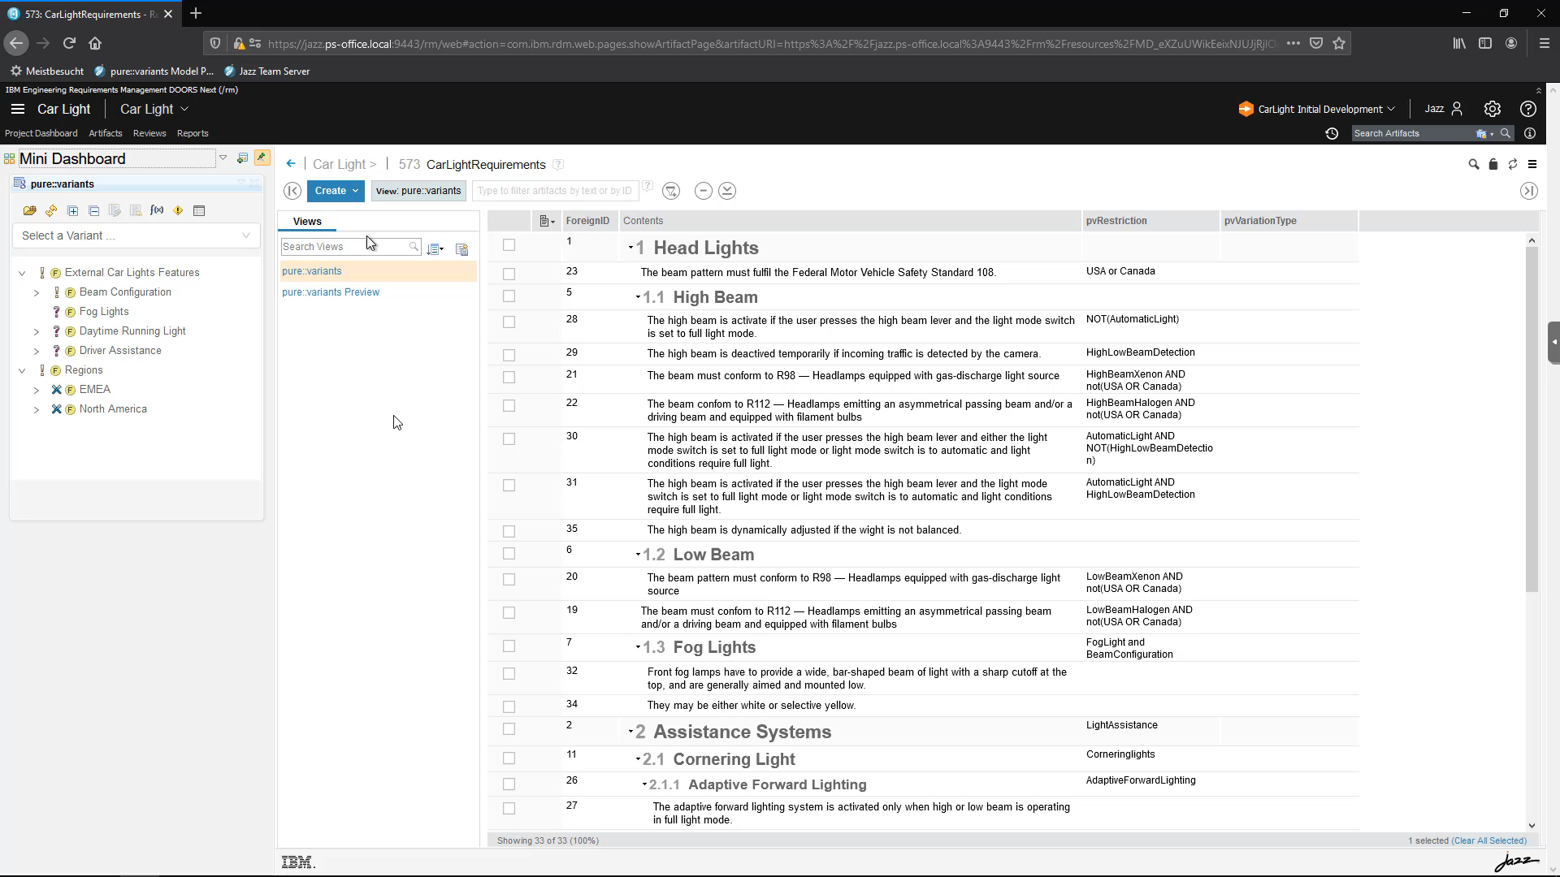
Preview in DOORS Next
Notes:
- transformation: update existing destinations and generate new ones (BaseLight Austria)

Slide 13
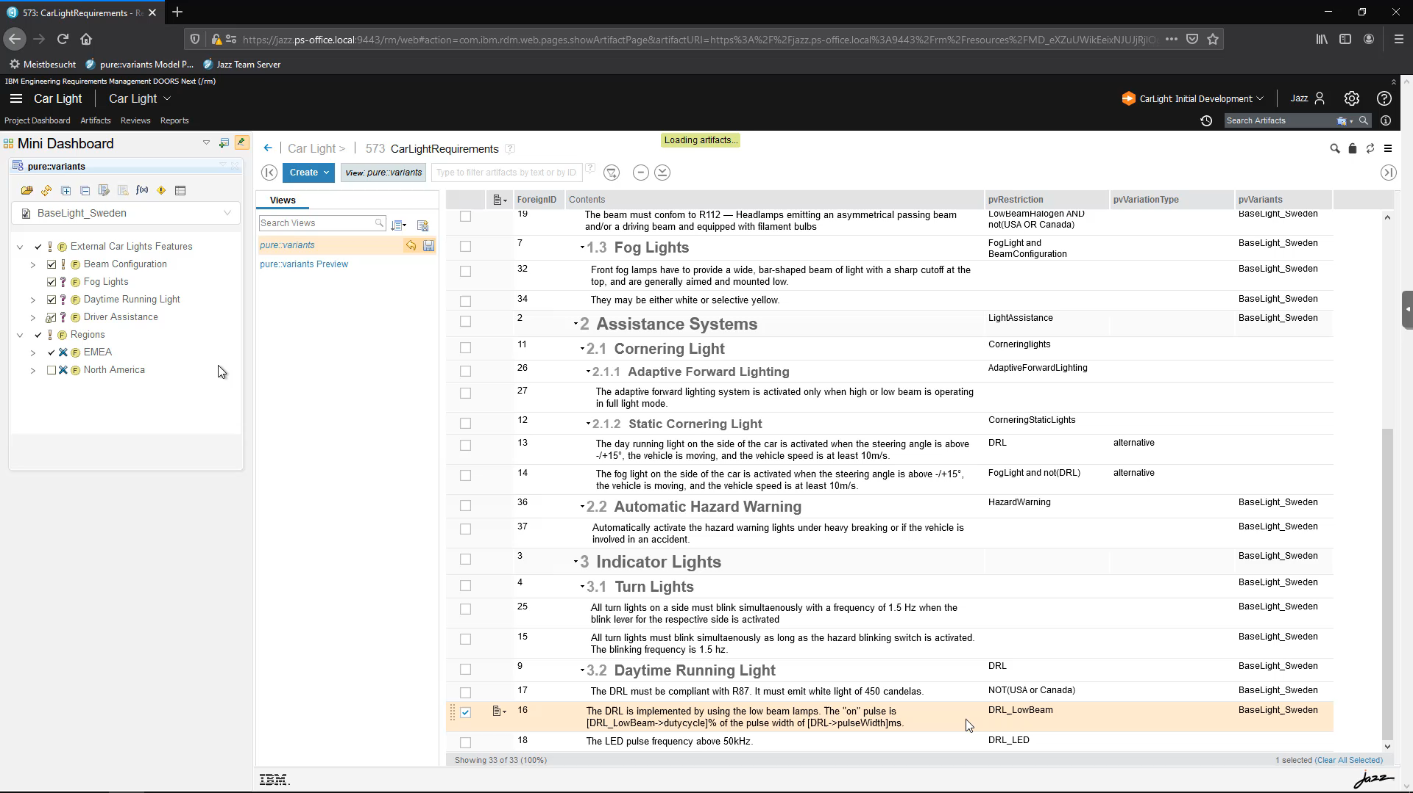
Generating a Global Configuration
Notes:
- transformation: update existing destinations and generate new ones (BaseLight Austria)

Slide 14
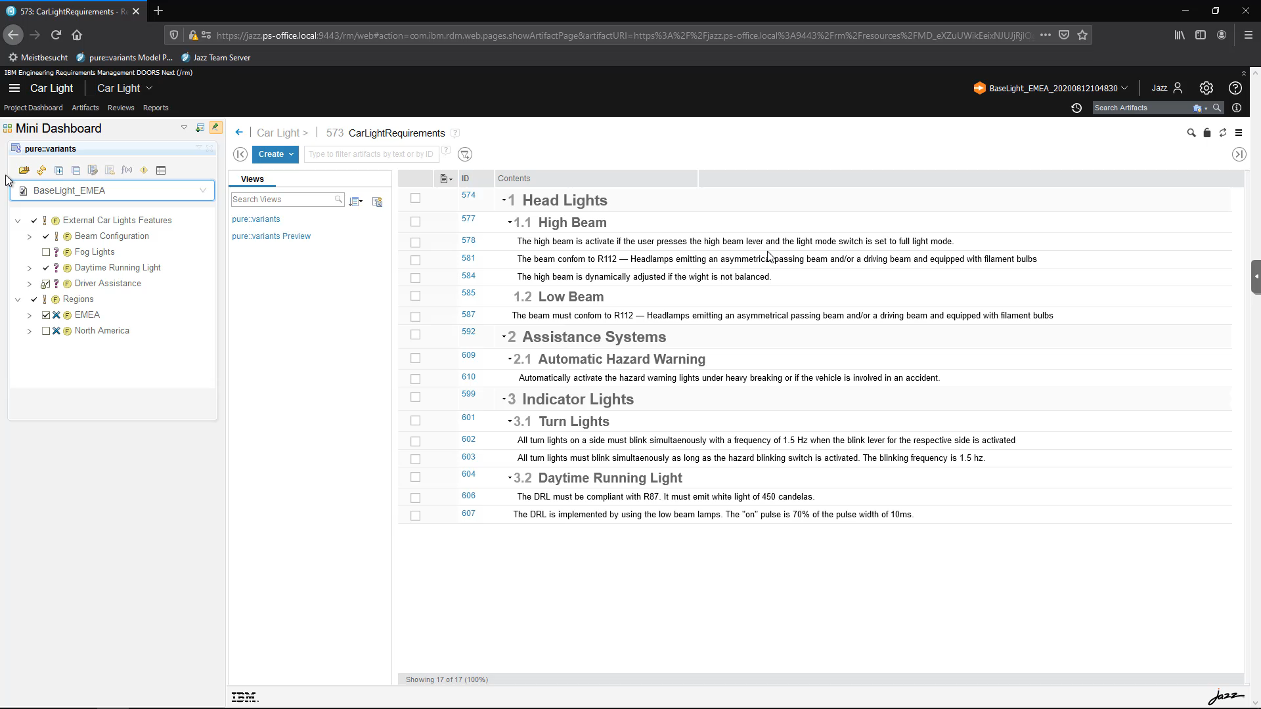
Updating an existing variant
Notes:
- transformation: update existing destinations and generate new ones (BaseLight Austria)

Slide 15
Takeaways
Global Configurations are great for managing engineering data across tool borders
Baselining across engineering assets
Provide context for OSLC links across engineering assets
Can be branched
Product Line Engineering is great for systematic reuse of engineering assets
Formalized & persistent interdependency knowledge
Feature Models provide the level of abstraction to beat complexity
Engineering assets can be created and maintained centralized
Engineering assets for a variant can be generated (automated reuse)
Global Configurations and Product Line Engineering are a perfect match

Slide 16
Takeaways
Global Configurations are great for managing engineering data across tool borders
Baselining across engineering assets including feature models and variant models
Provide context for OSLC links across engineering assets which can be used to link features to assets
Can be branched so a product line engineering tool can instanciate a GC branch for each variant
Product Line Engineering is great for systematic reuse of engineering assets
Formalized & persistent interdependency knowledge
Feature Models provide the level of abstraction to beat complexity
Engineering assets can be created and maintained centralized
Engineering assets for a variant can be generated (automated reuse)
Global Configurations and Product Line Engineering are a perfect match

Slide 17
Thank You!

